Slide 1






Building Robust CI/CD Pipelines with GitHub Apps and Custom Automation
Emanuel Palm Cloud Specialist & Microsoft MVP @ Unwonted
@PalmEmanuel

Slide 2

🔁
MirrorRepo-Core
MirrorRepo-Internal

Slide 3
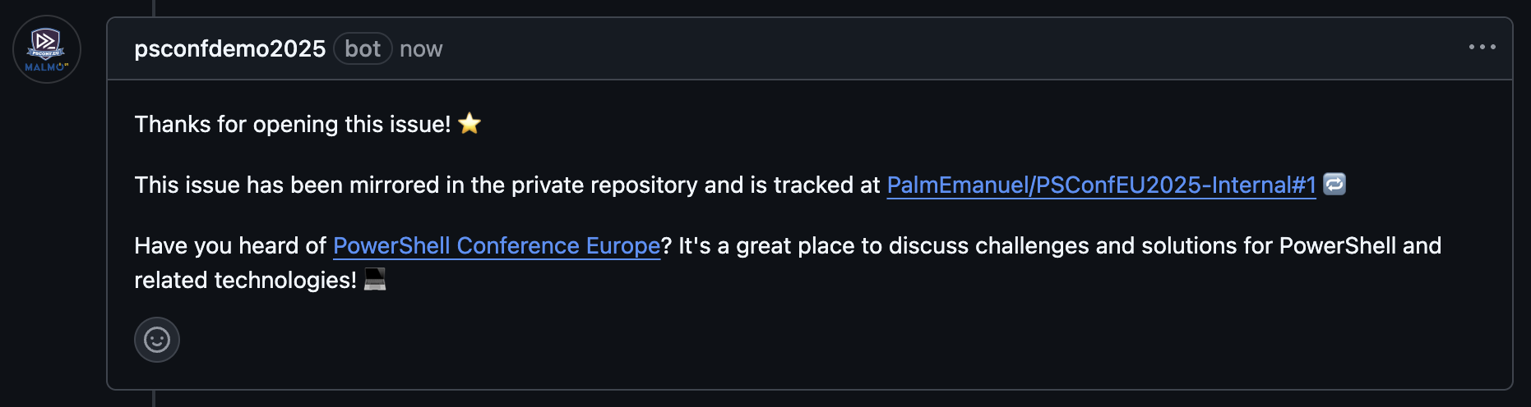

+1
MirrorRepo-Core
MirrorRepo-Internal

Slide 4
+1
+1
MirrorRepo-Core
MirrorRepo-Internal

Slide 5

+1
+1
MirrorRepo-Core
MirrorRepo-Internal

Slide 6
Mirror Issue to Internal Repo
+1
+1
MirrorRepo-Core
MirrorRepo-Internal
Post Comment on Original Issue

Slide 7

Emanuel Palm
💙 Everything-as-Code
📦 Makes modules & tools
📃 Fan of Open Source
☁️ Blogs at pipe.how
Fun facts!
☕️ Coffee roasting
🏃 Running
🥏 Disc Golf
🇸🇪
Cloud Specialist, Microsoft MVP
@PalmEmanuel

Slide 8
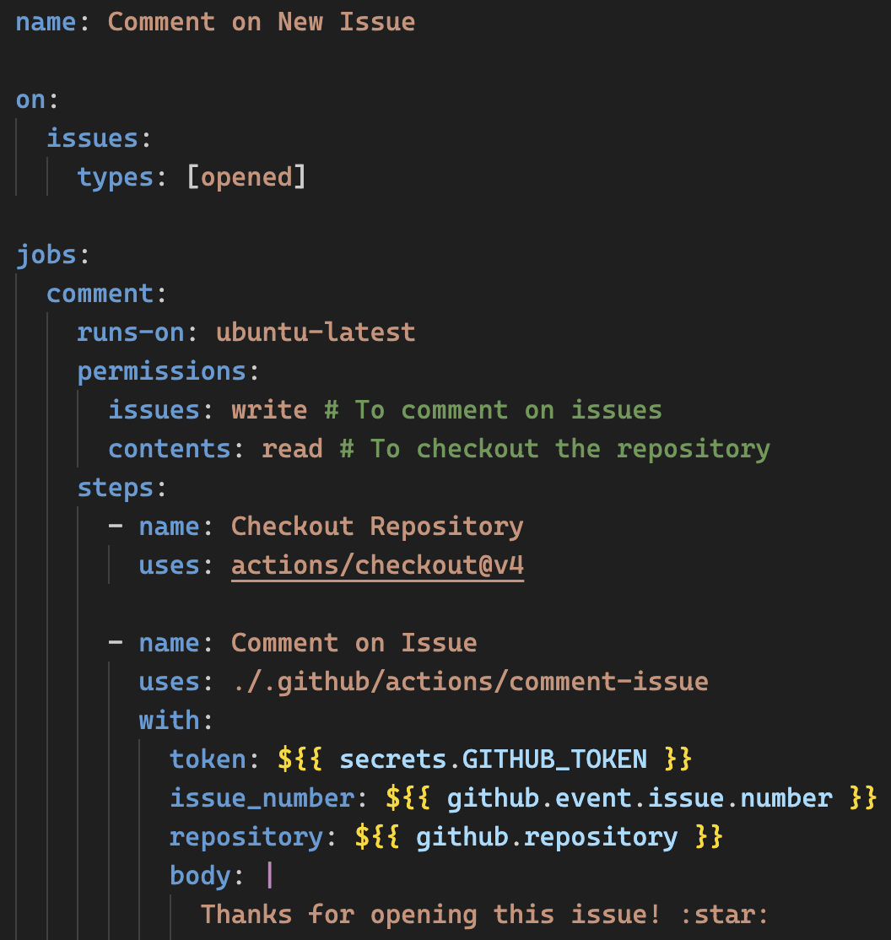
Example of a GitHub Workflow

Slide 12
GitHub Apps
Extend GitHub functionality
Work with Events & Webhooks
There are also older “OAuth Apps”
Store Secrets & Private Keys securely

Slide 13
DEMO

Slide 14


Key Takeaways
GitHub Apps allow us to extend GitHub
Cross-repository permissions
We explored issue creation & comments
But any event is possible with webhooks
Opens the door to any automation
Improve organization & developer productivity
@PalmEmanuel

Slide 15

Thank you!
@PalmEmanuel

